Slide 1


eSTEeM conference 2025
Does sharing slides in advance of online learning events impact student attendance?
Conference Title
Conference dates
Jenny Duckworth, Jennie Bellamy &
Harriet Marshall
Faculty of Science, Technology, Engineering and Mathematics
School of Environment, Earth and Ecosystem Sciences

Slide 2


Background
Engagement with tutorials is key to student learning and can reduce isolation on online modules
Access to slides in advance of online tutorials is thought to benefit many students e.g. those with declared and undeclared disabilities and EAL
It is not known how advance slide sharing impacts OU online tutorial attendance
Literature reports both positive (e.g., Babb & Ross, 2009) and negative (e.g., Léon & García-Martínez, 2021) effects on attendance from advance slide sharing
  Babb, K.A. and Ross, C. (2009) ‘The timing of online lecture slide availability and its effects on attendance, participation and exam performance’, Computers and Education, 52, 868-881.
  Léon, S.P. & García-Martínez, I. (2021) ‘Impact of the provision of PowerPoint slides on learning’, Computers and Education, 173, 104283.

Slide 3
Project aims
Establish existing online tutorial slide sharing practice amongst tutors in terms of where and when they are shared with students
Establish existing practice of students in accessing and utilising online tutorial slides in advance of tutorials
Identify the perceived benefits of and barriers to sharing and accessing slides in advance of tutorials by tutors and students
Inform and develop recommendations on good practice in slide sharing.

Slide 4
Approach
Focus on 3 modules in School of Environment, Earth and Ecosystem Sciences at Stages 1 (S112), 2 (S(XF)206) and 3 (SDT306)
Initial analysis of tutor slide sharing practice via tutor group and cluster forums (2022-2023)
Online surveys of around 2000 students and 100 tutors (2023-2024)
Focus group discussion with Student Support Team.

Slide 5
Slide sharing via forums
Slides not always shared in advance
Module team guidance and tutor practice varies with module
Does not include sharing via email
Based on random sample of 33-50% of tutors on 3 TG and 2-3 cluster tutorials per module

Slide 6
Survey: Tutor perspective
We asked the tutors:
When they shared tutorial slides
How they shared slides in advance
What do they consider benefits in sharing slides in advance
What do they consider challenges/disadvantages in sharing slides in advance

Slide 7
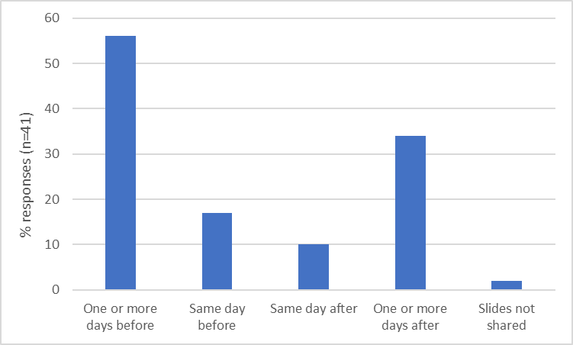
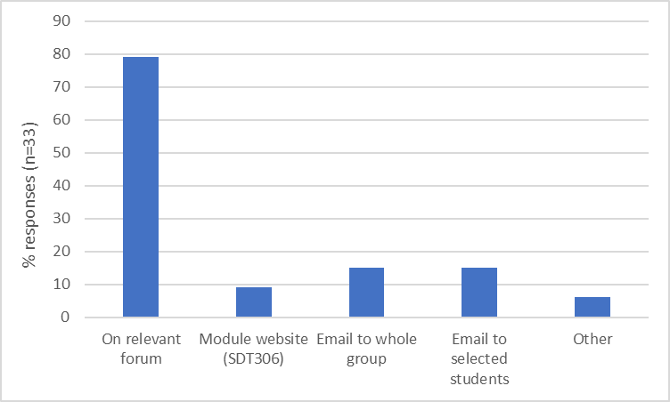
Survey: Tutor perspective
When do you share slides?
If you share slides in advance, how do you share them?

Slide 8
Survey: Tutor perspective
Tutors said about advance slide sharing:
However, they also said:
One student told me ‘I just wished all tutors would do that’ (share slides in advance)
‘It should just be standard, expected practice from all tutors’
‘This is normal practice at my other HEI’
‘I remove the slides with answers to questions and solutions to maths problems’
‘Students are less likely to attend’
‘Slides don’t tell the whole story’
‘It’s not always convenient [to prepare slides early]’
‘Students see answers’

Slide 9
Survey: Student perspective
We asked the students:
Are you aware slides are shared in advance of learning events?
Where would you look for slides?
If you access slides, what do you do with them?
Does accessing the slides affect your attendance at the learning event?
Why have you accessed slides, what are the benefits?

Slide 10
Survey: Student Perspective
Students said about advance slide sharing:
There were far fewer disadvantages identified:
'It's just bullet points'
'No sense of surprise'
'Creates at least a temptation to avoid lectures'
‘less anxiety around the tutorial’
‘easier to take notes’
‘use my access[ibility] software’
‘enables me to prepare’
‘helps understanding due to dyslexia’
‘helps me concentrate and feel more motivated’
'take more part in discussions and ask questions

Slide 11
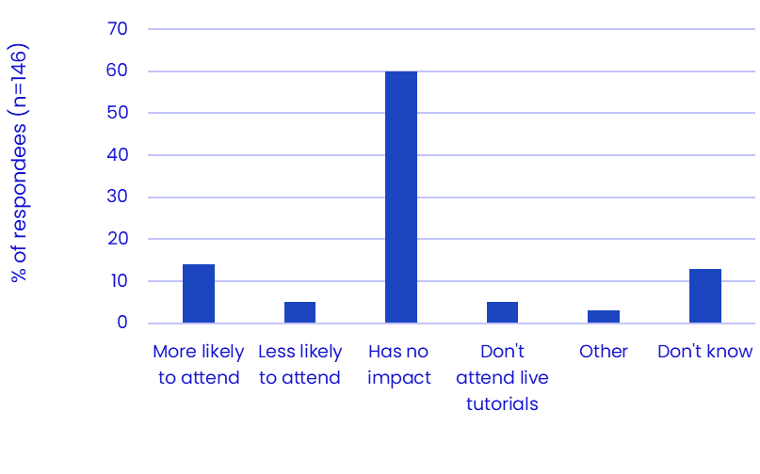
Survey: Student perspective
Do students find accessing slides in advance useful?
Does accessing slides in advance affect student attendance?

Slide 12

What students do with slides:
We asked, ‘If you access the slides, what do you do with them?’
Students could choose any that apply
Number of students (n=146) | Option chosen
42 | I save/print the file and read through in advance
42 | I download/print and have in front of me during the event
41 | I review the slides after watching the tutorial, perhaps adding notes
26 | I write notes on the slides during the event
26 | I save the file

Slide 13
Student Support Team (SST) Perspective
A focus group was held with members of the SST
Main themes identified were:
Making slides available could reduce anxiety for students and help them feel prepared:
‘a lot of anxiety is fear of the unknown’, and ‘gives [students] an idea of what's coming’
The need for a consistent approach across the university :
‘so I'm not setting any incorrect expectations’
A slight concern a few students may be overwhelmed or overprepare:
‘If [students] try to overthink it…’.

Slide 14

Summary
Key findings from the research
There is currently inconsistency in practice between modules/tutors
Students benefit from having tutorial slides in advance
Having slides available in advance does not have a negative impact on attendance
SST colleagues would welcome advance slide sharing on all modules.

Slide 15
Workshop Discussion
Your experience
Some of you were sent the slides ahead of this session
Some of you were given access to the slides ahead of this session
Some of you were not contacted ahead of this session

Slide 16
Workshop Discussion
To discuss in breakout rooms (10 minutes)
Did you receive the slides, or have access to them, or neither?
Did you look at the slides in advance of the session?
Did you do anything with the slides to prepare for the workshop?
Now imagine you are a student…..how do you feel about having the slides available in advance?
Would any barriers to learning be removed by having the slides in advance?

Slide 17
Thank you for your participation

Slide 18
Any questions?
For more information contact:
jenny.duckworth@open.ac.uk
jennie.bellamy@open.ac.uk
harriet.marshall@open.ac.uk

